Slide 1
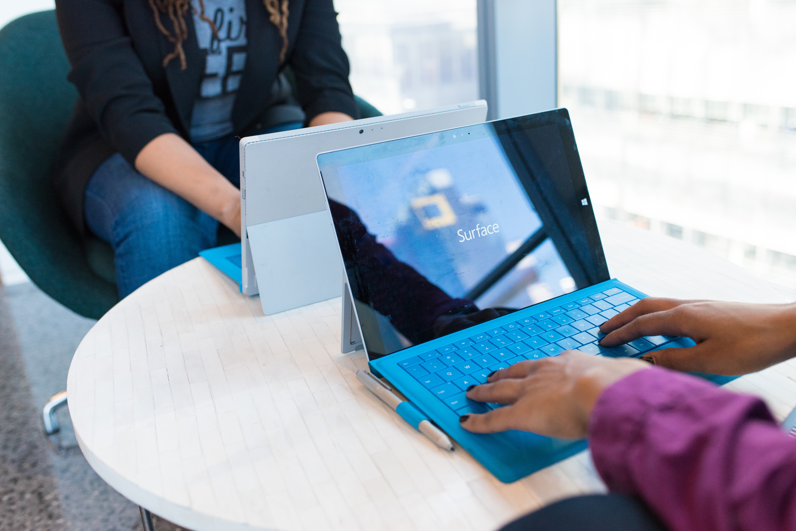
WELCOME TO
CLOUDHOUR
CloudHour will be starting shortly...
Please feel free to grab a drink and invite your friends!

Slide 2
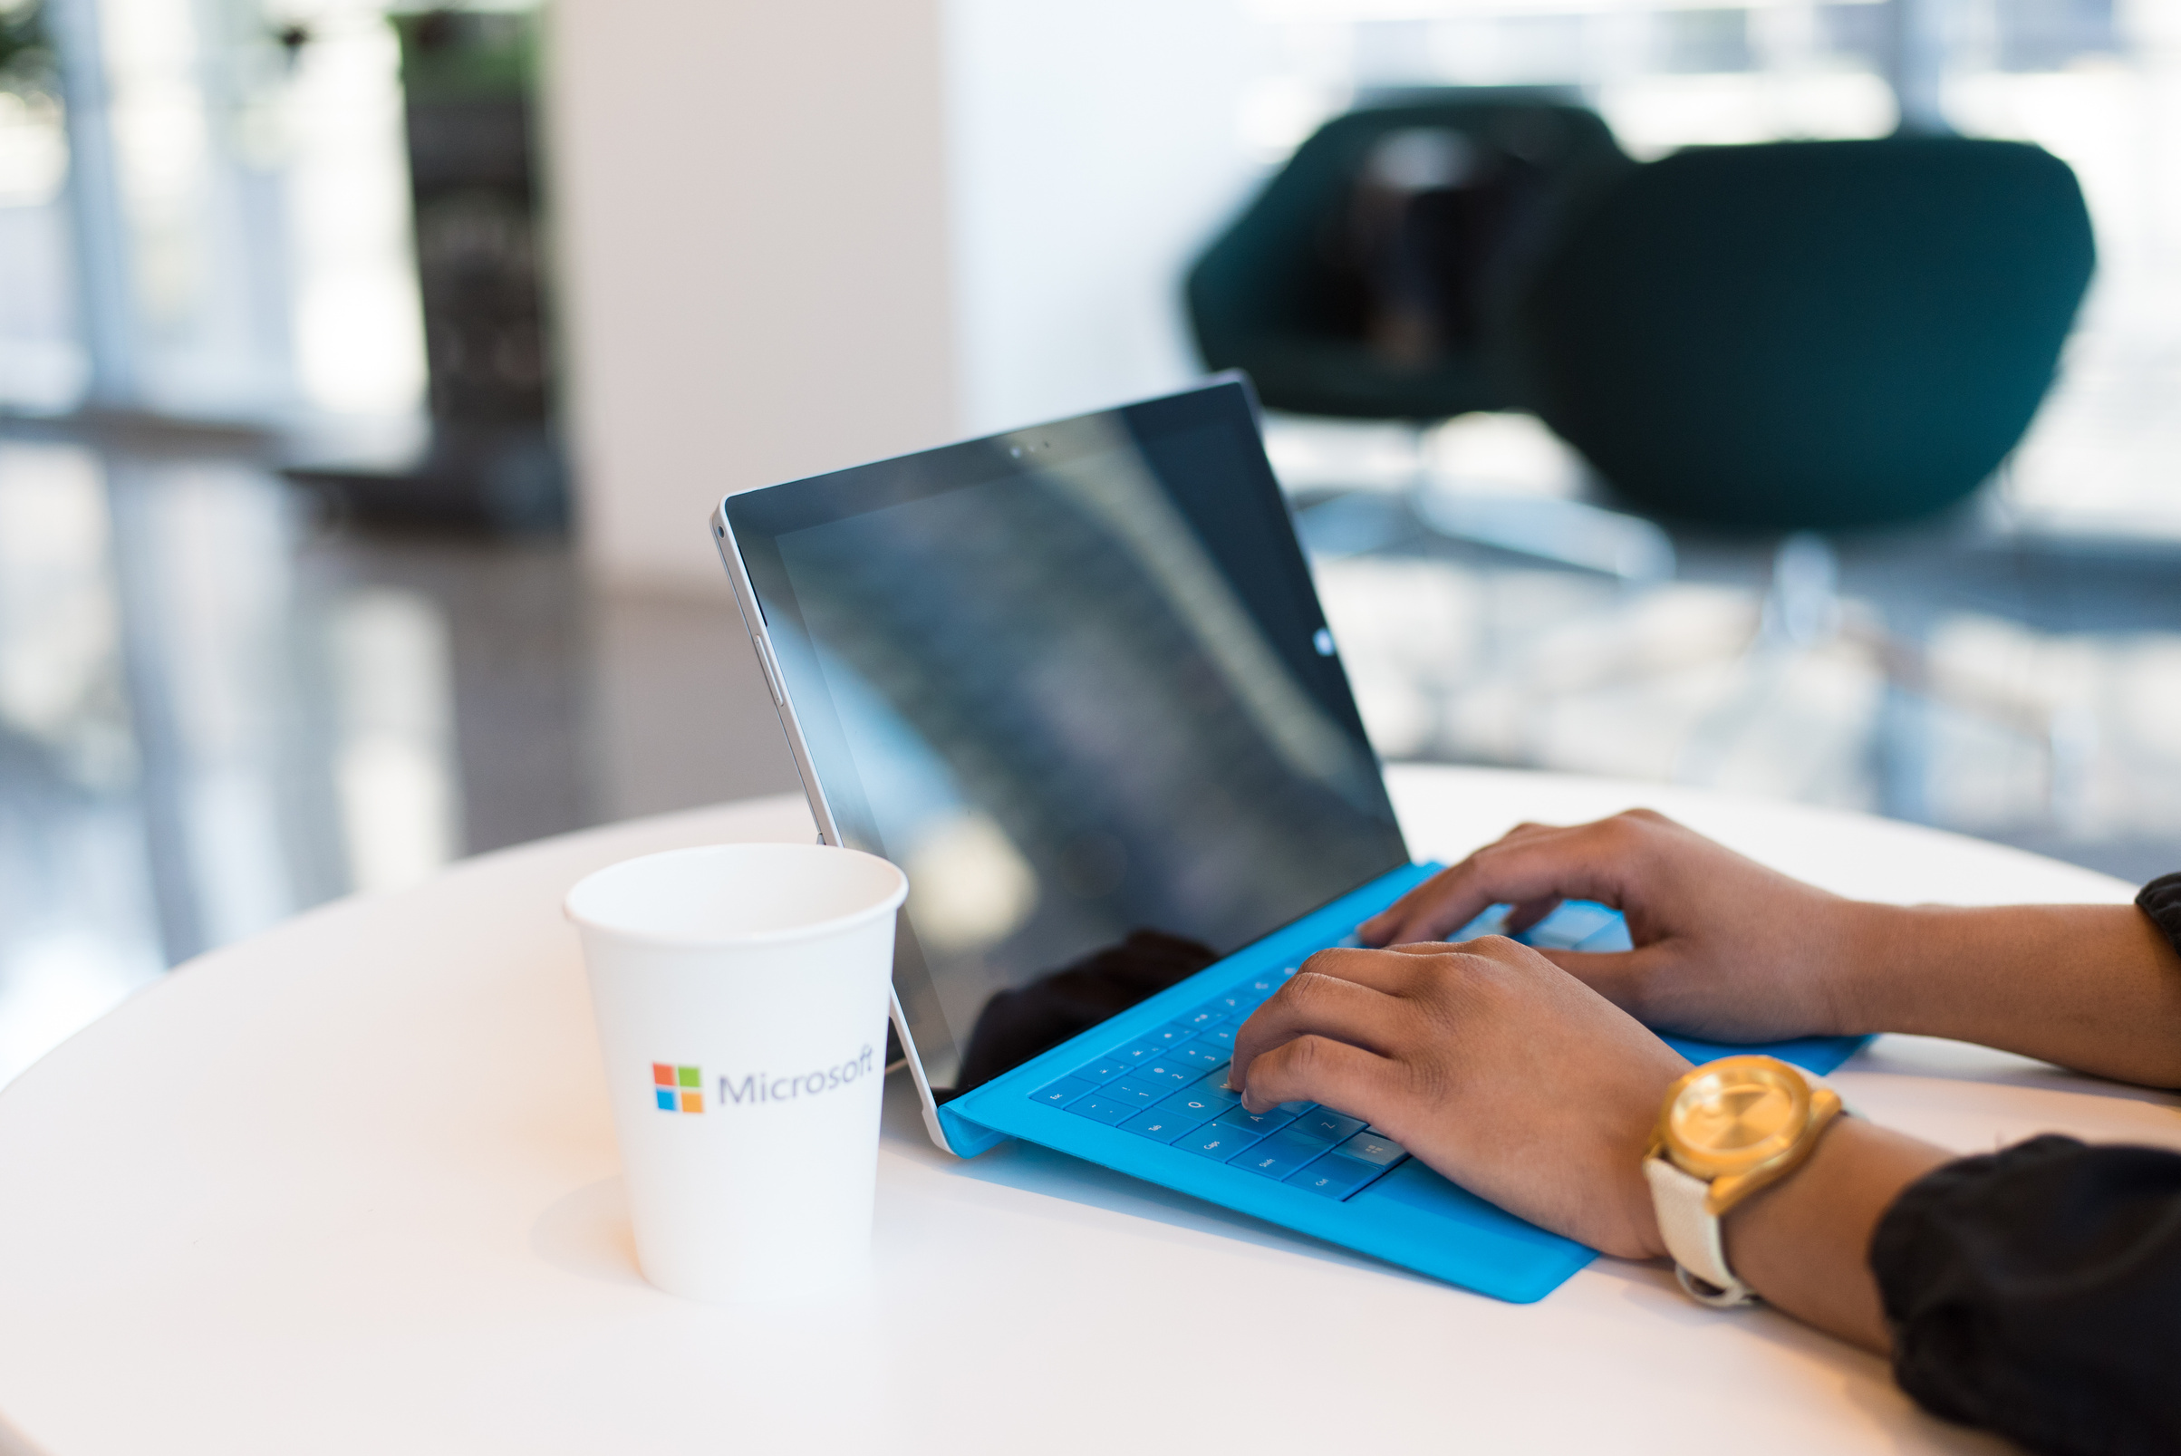
WHAT IS
CLOUD HOUR
CloudHour is a round-table discussion where we focus on a few key topics for collaborative discussion
Why it is important
Rapid changes in cloud security and tech
Stay updated and connected for growth as a community.
How will it benefit the community
Real-time engagement with hosts and community members
Ask open questions and speak your opinion
Opportunity to shape the next agenda

Slide 3
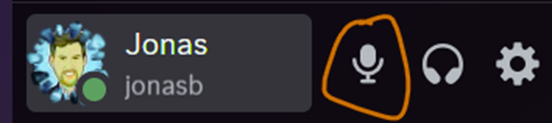
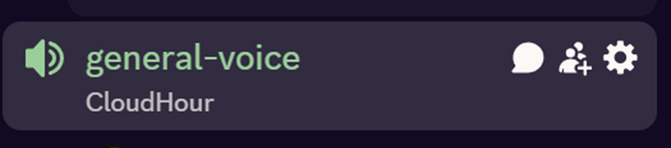
BEFORE WE
START
If you prefer not to talk or be asked questions, please press mute
Open mic is allowed
Remember to open the chat and engage with our community!

Slide 4

SHARING
LINKS TO SHARE
AZURE INFORMATION PROTECTION
Enable MFA for your Azure tenant (MC1143999)
AZURE INFORMATION PROTECTION
Enable MFA for your Azure tenant (MC1143999)
AZURE INFORMATION PROTECTION
Enable MFA for your Azure tenant (MC1143999)

Slide 5

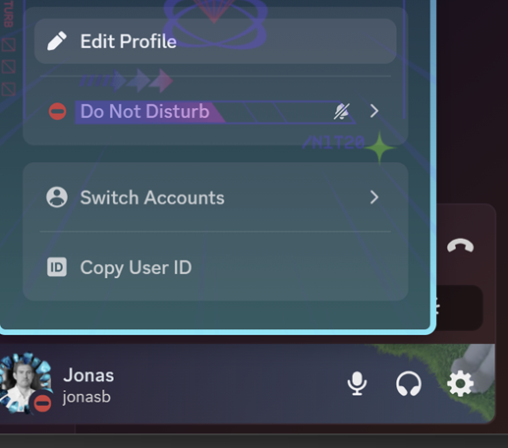
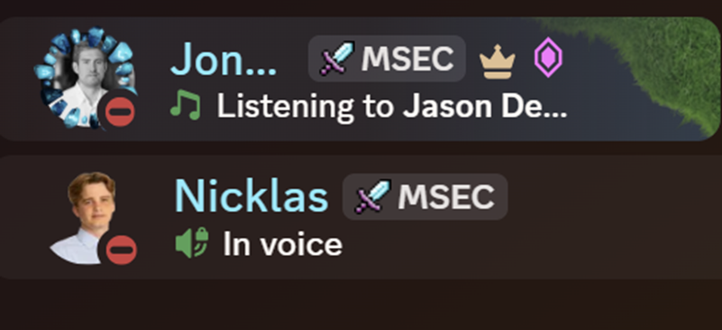
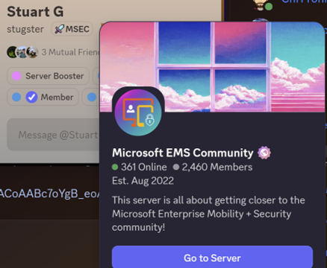
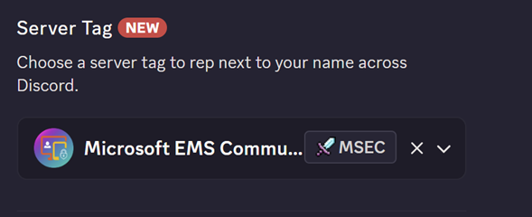

DISCORD
SERVER TAG

Slide 6

AGENDA
INTUNE
ENTRA
PROTECT AGAINST SHADOW AI
COMMUNITY TOOLS AND SCRIPTS

Slide 7
TOPIC
INTUNE
WINDOWS 10 EOL
Windows 10 EOL on 14th October. Are you ready? If not, get started today!
AZURE INFORMATION PROTECTION
Want to take backup of your system settings, credentials and Microsoft Store apps? Windows backup might be able to help you!

Slide 8
THANK YOU FOR JOINING
CLOUDHOUR
We hope that you found this session useful!
Please don’t forget to share our community with your friends and colleagues, and we look forward to seeing you next month!

